Slide 1

Part 4: Going Deeper, Managing Resistance and
Using Strengths
Notes:
This segment addresses the most challenging aspects of organizational diagnosis: uncovering the root causes that lie beneath surface symptoms, and working productively with the resistance that inevitably emerges. We'll explore both the techniques for digging deeper and the psychology behind why people resist - and explore opportunities for reframing our approach from problems to strengths.

Slide 2

Going beyond the surface
Time spent on reconnaissance is seldom wasted. It is better to identify the expectations of people […] that way we become aware of why people object to a particular change especially if it violates something of significance to them.
(Randall et al., 2019, p. 68)

Slide 3
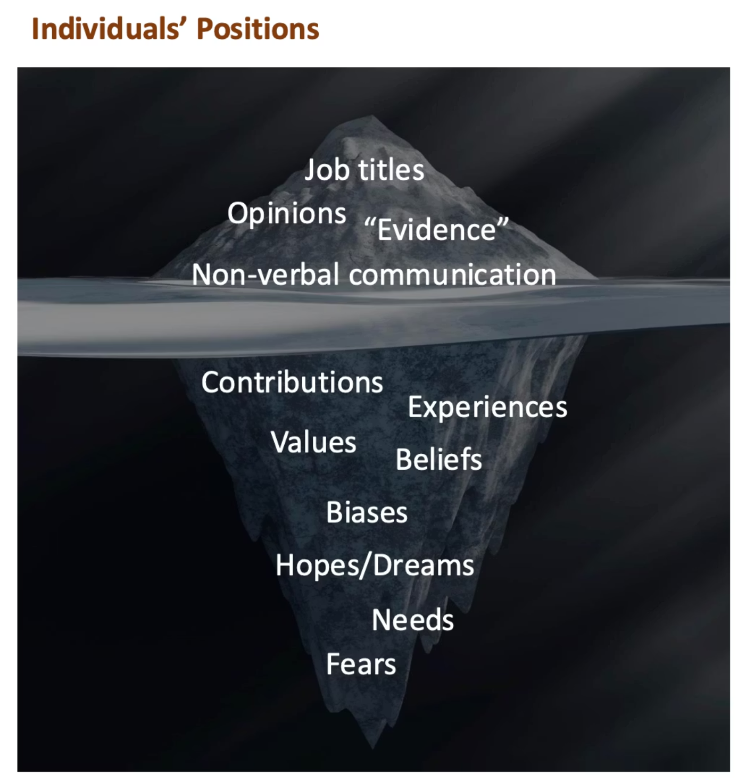
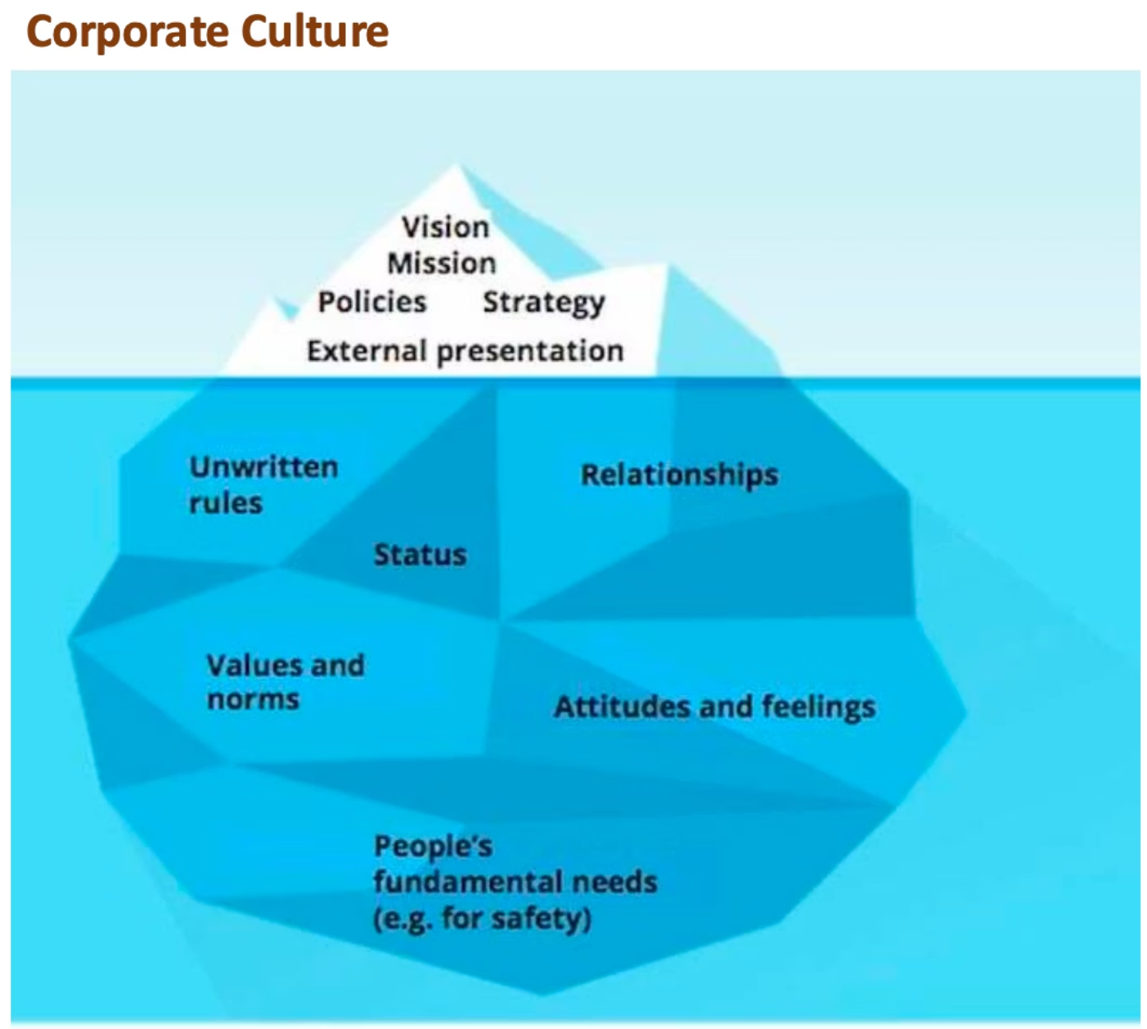
Icebergs all around (Hall, 1976)
Notes:
Edward Hall's iceberg metaphor reveals why surface-level data collection fails. Most of what matters in organisations remains invisible beneath the waterline.You need sophisticated methods—and trusted relationships—that reveal these deeper layers. This is why the "soft" skills of consulting are actually extraordinarily difficult to master.

Slide 4





Don't accept the first answer: the "five whys"
HELP: Customer satisfaction scores have dropped
Customers are waiting too long for support responses
Why?
1
2
Why?
Support team is overwhelmed with tickets
3
Many tickets are repeat issues that have not been resolved at first attempt
Why?
4
Why?
First-line staff lack authority to offer refunds or replacement
Why?
5
Company policy requires manager approval for all expenses

Slide 5


Why Diagnosis
Triggers Resistance
The Paradox
So …
Deeper diagnosis yields more valuable insights—yet simultaneously becomes more threatening to those being examined.
The more you uncover, the more resistance you may encounter.
This isn't a failure of your technique.
Learn to appreciate when resistance shows that you are on the right track (and when it shows that you are annoying).
Notes:
Resistance emerges not because our diagnosis is wrong, but often because it's precisely right ... and that truth feels uncomfortable. How do we work productively with this inevitable human response?

Slide 6


Resistance is Data!
"Those who feel in a position of power (tend) to feel threatened by the expert power of advisers and therefore (may) discount good advice, even at the cost of poorer performance."
—Mole (2016)
Reframe Your Perspective
Resistance is not (just) an obstacle to overcome —
it provides valuable information about the system you're diagnosing: about power dynamics, concerns, and what people value or fear losing.
When you encounter resistance, pause and ask yourself: What is this person protecting? What might they fear losing? What does this reveal about the organisational culture?

Slide 7




Client Resistance is Normal (Schein, 1987)
Initial Vulnerability
Defensive Responses
What about you?
Guilt, anxiety, or feelings of inadequacy from recognising things aren't working.
Resistance is the expression of that vulnerability:
Consider your own feelings before an unpleasant medical appointment.
Fear of facing difficult issues such as personnel changes or acknowledging personal shortcomings.
Being secretive or guarded with information. Reluctance to provide help or access.
Don't take resistance personally. Recognising the emotions can strengthen the consulting partnership.
Loss of the sense of control they're accustomed to experiencing.
Withholding the "real" problems whilst presenting safer issues. Outright denial that problems exist at all.

Slide 8



Clients Need to Keep Face
"Even before their arrival, consultants can expect audiences that are less
than reassured by their arrival; uncertain of the future; and suspicious of those brought in."
—Randall, Burnes & Sim (2019)
Help Clients Regain Status
Create Psychological Safety
Ensure They Feel in Control
Build confidence in their own abilities through genuine collaboration and recognition of their expertise and contributions.
Establish an environment where clients feel prepared to learn without fear of judgement.
Clients must believe they retain agency over what is happening, even as they accept guidance and change.
Some client requests may contradict these (e.g. performance assessment of individuals, consultants taking too much ownership) — then this needs to be negotiated in contracting and beyond.

Slide 9
From Doctor to Coach (Block, 2010)
Traditional medical model
Diagnosis → Prognosis → Prescription
has consultant expert in charge,
and can reinforce client helplessness.
Instead, a coach would
focus on possibilities
Reveal strengths, generate excitement for creating a new future, and engage in discovery and dialogue rather than prescription.
Without ignoring problems, a possibility focus mobilises energy and creativity rather than triggering defensiveness and dependency.

Slide 10


Positive Approaches to Diagnosis
Positive Deviance
Appreciative Inquiry
Pascale, Sternin & Sternin (2010)
Cooperrider & Srivastva (1987)
Look for solutions already existing, often "invisible in plain sight"
What's working well and worth sustaining?
What dreams or visions already exist?
Find successful exceptions: people who've already solved the problem
5D cycle: Definition → Discovery → Dreaming → Designing → Destiny
Observe (don't merely interview) how they do things differently
Building on what works is often considerably easier — and usually more empowering.
Notes:
Two specific methodologies demonstrate how to shift from problem-focused to possibility-focused diagnosis Both methodologies shift energy from problems to possibilities, proving particularly useful when clients feel demoralised or defensive Building on what already works is often considerably easier than fixing what's broken—and generates more sustainable change.

Slide 11

Reflective diagnosis
"A good Consultant is like a 'Detective'"
—Cockman et al. (1999)
"Everything counts!"
—Block (2010)
"People almost invariably arrive at their beliefs not on the basis of proof but on the basis of what they find attractive.”
—Blaise Pascal (1660)

Slide 12



What's next?
When have you encountered resistance to change, in yourself or others? Looking back, what was that resistance trying to protect?
Prepare for the live session
Complete the core readings (note the or) and
look through the written content
Explore at least one diagnostic approach of interest to you
(e.g., Root Cause Analysis, positive deviance, people analytics, AI)
Bring your questions and comments on the readings and preparation materials
See you soon.

